Slide 1

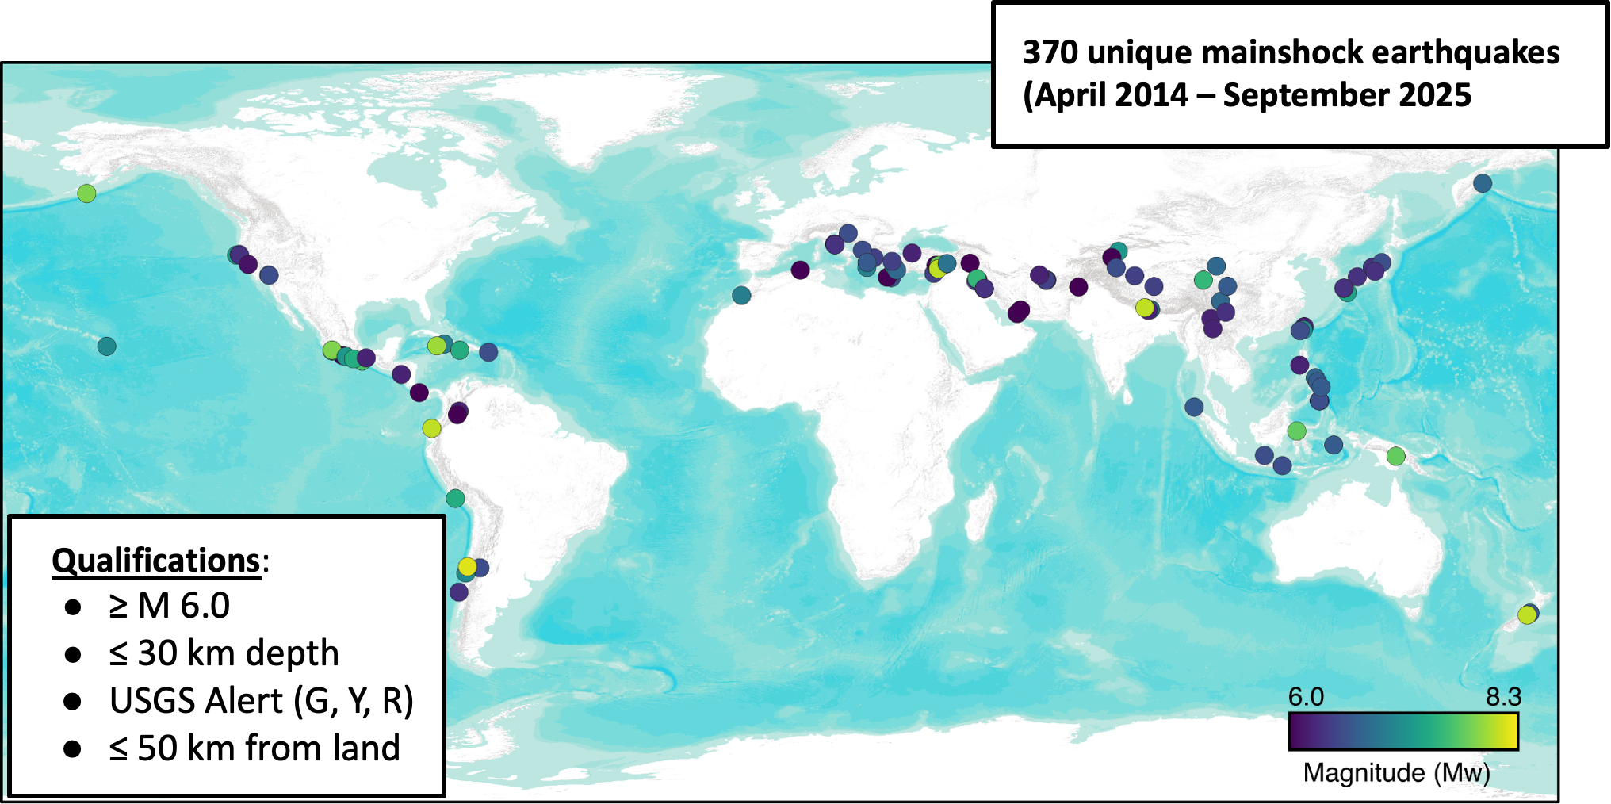



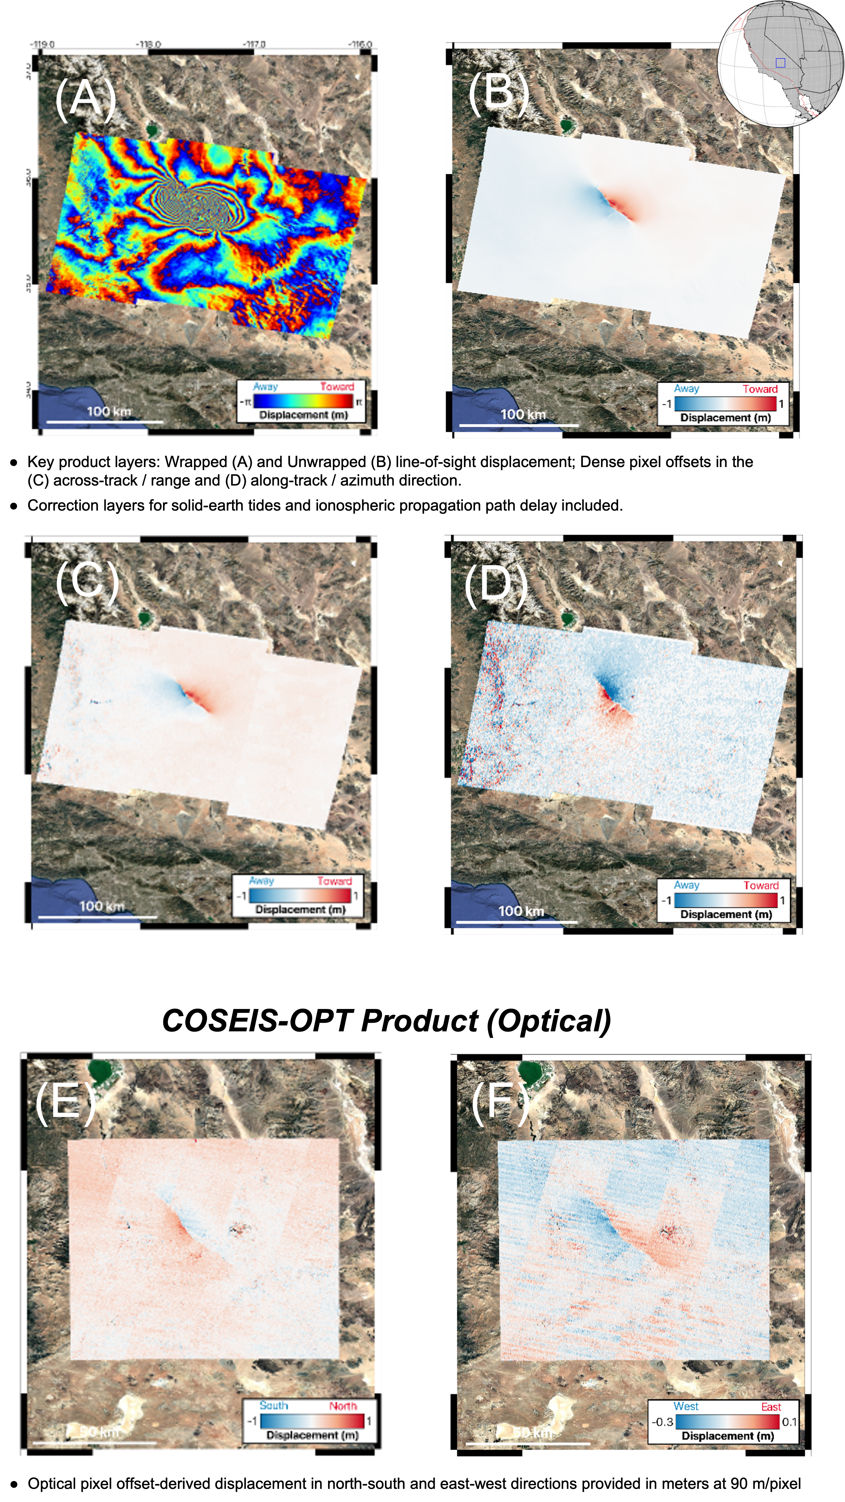
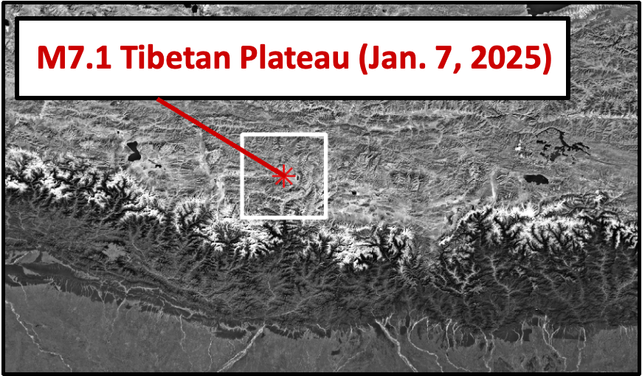
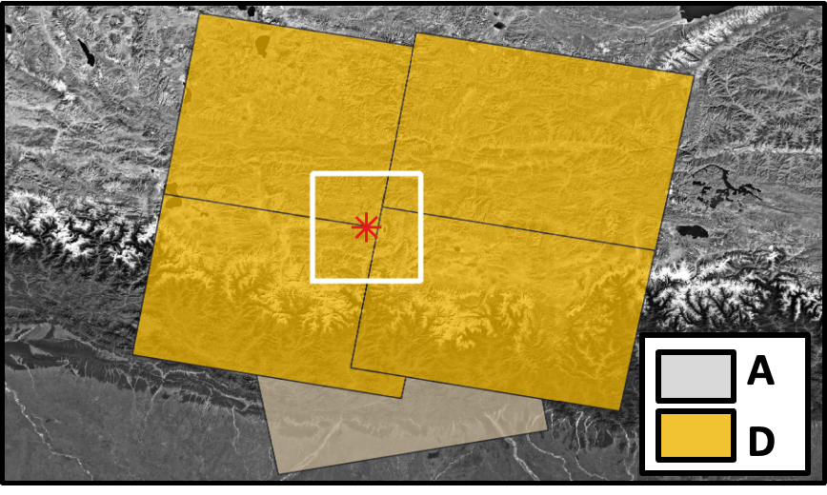
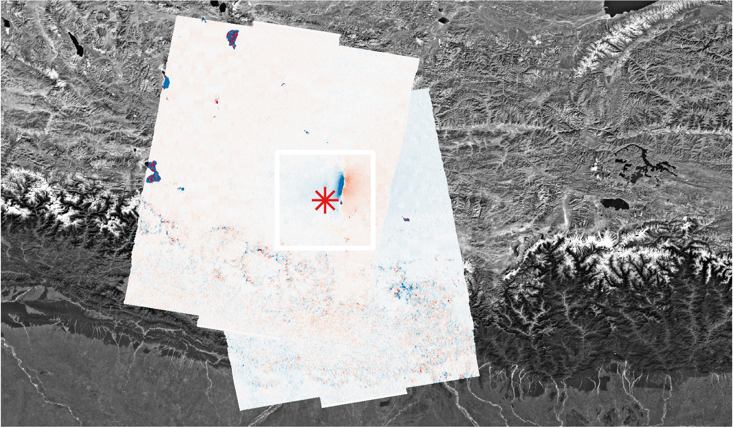
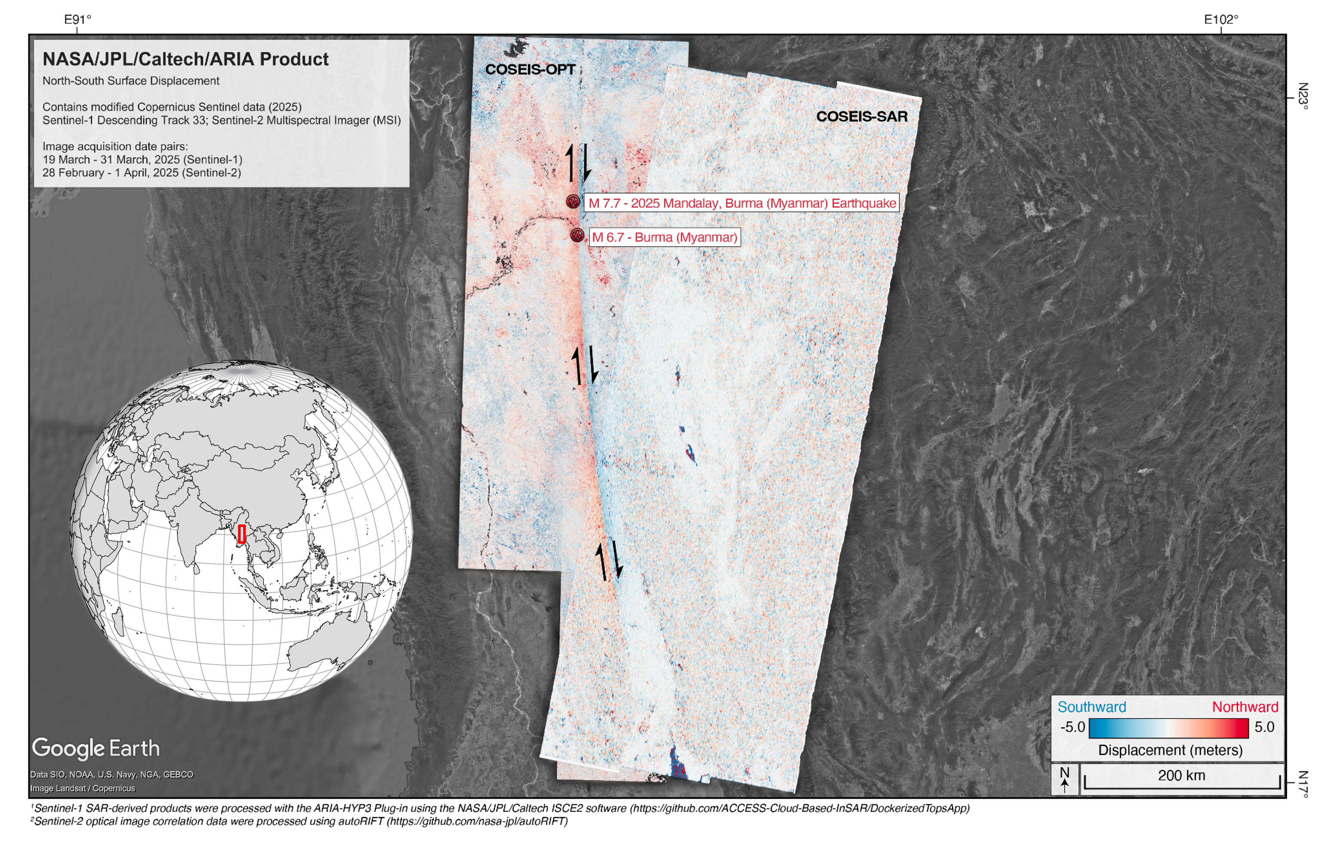
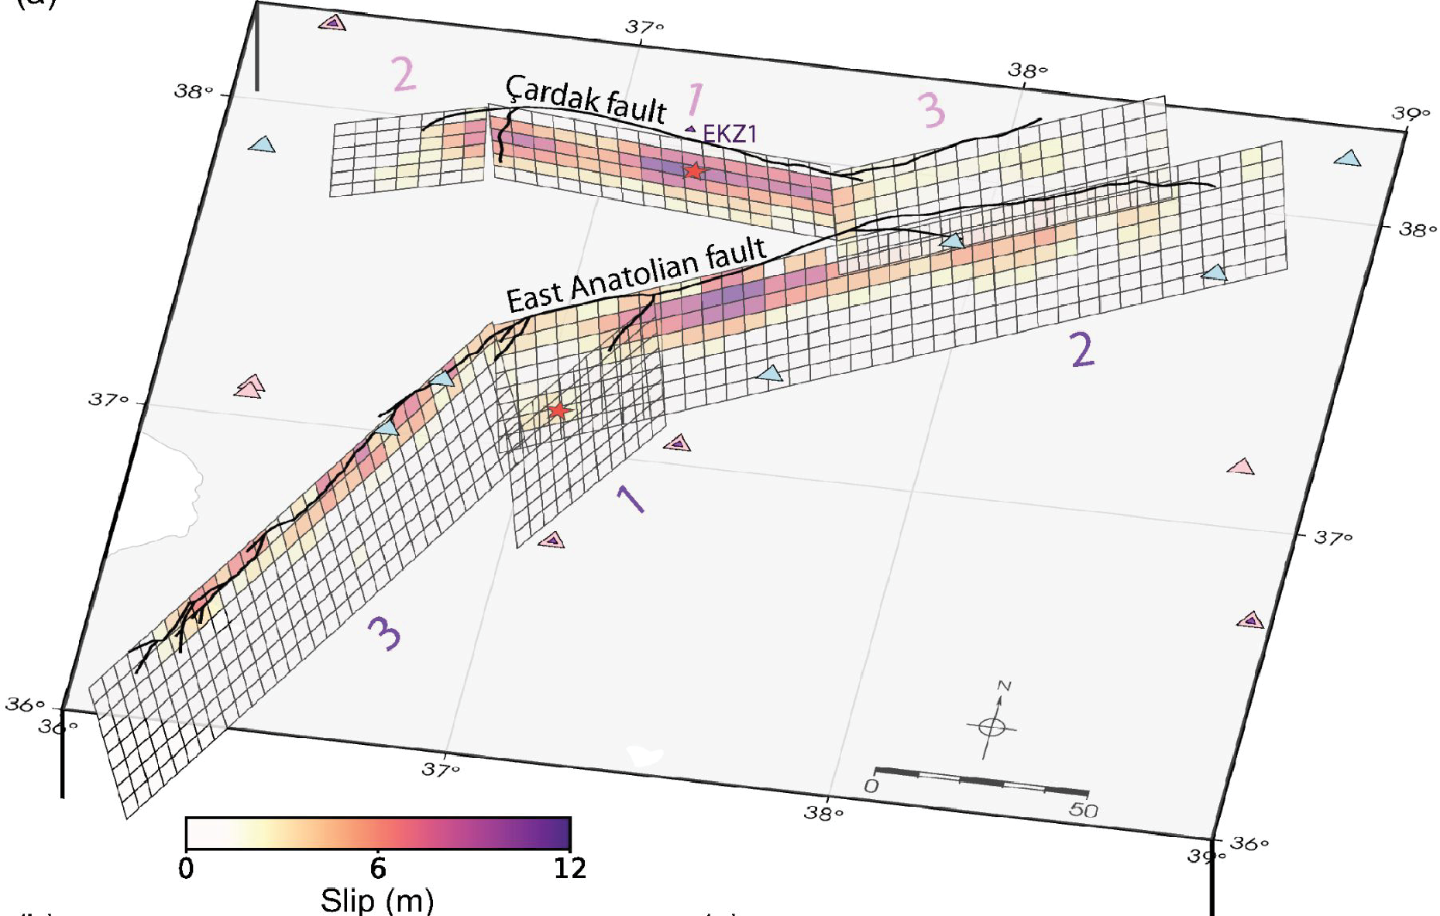
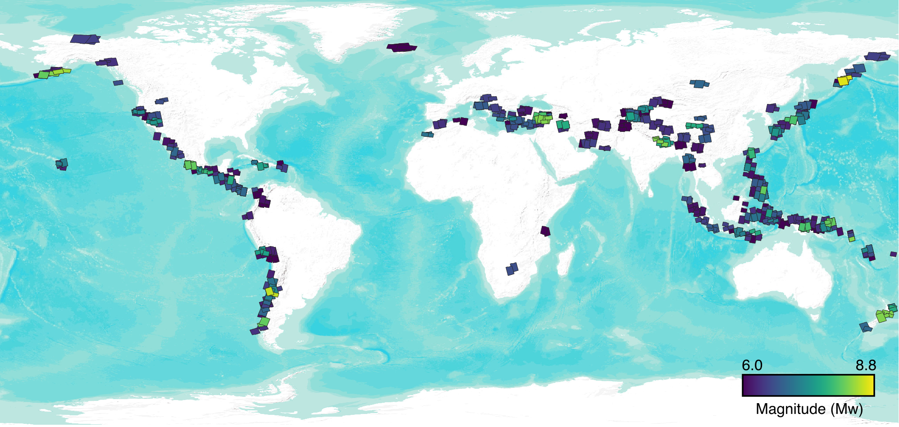

National Aeronautics and Space Administration
Postdoc Research
A global "one-stop-shop" of coseismic displacement products from spaceborne SAR and optical imagery for earthquake science and disaster response
Author: Cole Speed, JPL Postdoctoral Fellow (334H)
Collaborators: M. Grace Bato (334H), Simran Sangha (334H), Charles Marshak (334H)
Affiliation: Jet Propulsion Laboratory, Pasadena, CA
Background and Objectives
Large, shallow earthquakes pose a global threat to human safety and infrastructure. We are developing a comprehensive, standardized database of surface displacement products from SAR and optical datasets – a global “one-stop-shop” for satellite-derived earthquake deformation estimates. Focused on historic events (≥ M6.0, ≤ 30 km depth) from 2014 onward, product generation will leverage automated cloud-based processing. Sensor-neutral products will be delivered through a user-friendly web portal for seamless integration into GIS platforms and modeling workflows. For future earthquakes, the workflow will auto-trigger, providing low-latency displacement estimates to support both scientific analysis and disaster response efforts.
Approach: Automated Processing Workflow for Historic and Future Earthquake Products
Results: Global database of SAR / Optical Data Products
SAR displacement products
Optical products
Query USGS Earthquake Portal API to identify earthquakes meeting significance criteria
Construct Area of Interest (AOI) based on USGS FFM or 100 x 100 km polygon
Simultaneously run cronjob hourly to identify new earthquakes and build processing jobs
Identify pre- and post-earthquake Sentinel-1A/B SAR and Sentinel-2A/B/C (optical) imagery intersecting AOI
Construct jobs using pre- and post-earthquake images (coseismic pairs) for all intersecting tracks
SAR/InSAR Product: NASA-JPL ISCE2 software
Outputs: Interferograms, pixel offsets
Optical Product: autoRIFT software
Outputs: Pixel offsets
Run hundreds of jobs in parallel with ASF HyP3, dramatically accelerating product generation
Multi-layer SAR and optical products provide complementary displacement estimates for 370 unique earthquake events, across a variety of tectonic settings.
Products delivered in sensor-neutral format for rapid integration and use in downstream modeling workflows by the end-user (NASA/JPL/EQ Community).
Application and Significance: M7.8 Myanmar Earthquake (28 March 2025)
Future Work: Interactive dashboard and Jupyter notebooks for greater data accessibility
Data products will be provided to NASA Disaster Response Coordination System (DRCS), enabling more rapid disaster response and understanding of earthquake surface rupture extent.
Developing interactive dashboard to explore data and user-friendly notebooks for data application.
National Aeronautics and Space Administration
Jet Propulsion Laboratory
California Institute of Technology
Pasadena, California
www.nasa.gov
Publications
Speed, C.M., Zinke, R., Bato, M.G., Fielding, E.J., Bekaert, D. (In-prep). A global "one-stop-shop" of coseismic displacement products derived from spaceborne SAR for earthquake science and disaster response applications.
Acknowledgements:
Author Contact Information:
cole.speed@jpl.nasa.gov
One-stop-shop of coseismic displacement products
This work is supported by the “One-Stop-Shop of Coseismic Products” project funded by NASA’s ROSES Earth Surface and Interior (ESI) focus area (23-ESI23-0012) to enhance understanding of earthquake mechanisms and support disaster response.
Clearance Number: CL#00-0000
Poster Number: Postdoc-E-006
Copyright 2024. All rights reserved.

